Slide 1
Grant Bourzikas Case Study 2
Doing Data Science MSDS 6306 – Fall 2018 Sadler

Slide 2
Building a Employee Focused Culture
Exploring Your Greatest Assets
Understand Why Attrition Occurs
Predicting Attrition in your Organization

Slide 3
Exploring Your Greatest Assets
Received 1470 Employee Records and performed analysis, regression and machine learning, of the Employee data set.
Drive an understanding of why Employees make decisions to leave your organization.

Slide 4
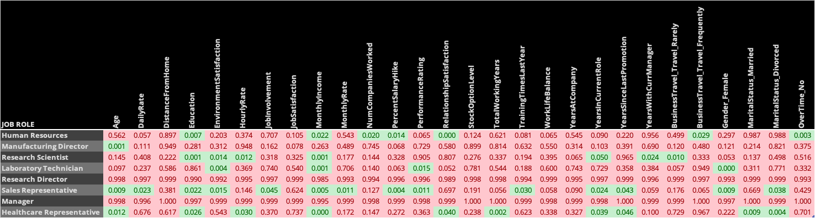
Understand Why Attrition Occurs
The above chart utilized Logistic Regression to Identify Significant indictors for each Job Role
By splitting the dataset, key attributes were identified by role vs. generic organization attributes
Utilized this data to predict attrition by identifying the following:
Key indicators, in green, that drive of Attrition
Noise, in red, that do not drive attrition.

Slide 5
Predicting Attrition in your Organization
Nearest Neighbors
Accuracy : 84%
Sensitivity : 100%
Specificity : 2%
Nearest Neighbor Weighted
Accuracy : 84.3%
Sensitivity : 100%
Specificity : 4%
Logistic Regression
Accuracy : 87%
Sensitivity : 97%
Specificity : 35%
Logistic Regression with LASSO
Accuracy : 86%
Sensitivity : 97%
Specificity : 35%
Results Key
49 employees with Attrition
251 employees with No Attrition

Slide 6
Questions?

Slide 7
Appendix

Slide 8
URL’s
YouTube Video
https://youtu.be/kGOE1Jl12PE
GitHub
https://github.com/gbourzikas/DDS6306/tree/master/Project2

